Slide 1
Machine Learning Introduction to Machine Learning by Kumar Anurupam is licensed under a Creative Commons Attribution-4.0 International License.
Machine Learning
Logistic Regression - II
CS 3104 Fall 2019
Lecture Slides by Kumar Anurupam

Slide 2
Learning Objectives
After completion of today’s session you will be able to:
Discuss the need of logistic regression
Analyze the formula for logistic regression

Slide 3
Problems with the Linear Approach
The probabilities are bounded as, 0 ≤ p ≤ 1
The range of Hours is observed as, 20 ≤ Hours ≤ 55
The probability that a 35 Hours studying student will pass:
p = -1.700 + 0.064 * 35 = 0.54
The probability that a 25 Hours studying student will pass:
p = -1.700 + 0.064 * 25 = -0.09
The probability that a 45 Hours studying student will pass:
p = -1.700 + 0.064 * 45 = 1.20
(Incorrect Outcome)
(Incorrect Outcome)

Slide 4
Fixing the approach
We know that p = f(Hours), but it is not working here.
The f(Hours) must satisfy two criteria's:
It must always be positive, and
It must be less than 1
So how can we achieve both the constraints?

Slide 5

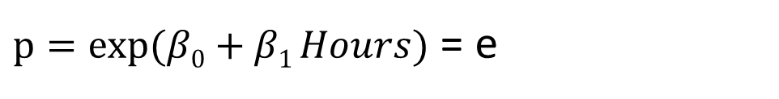

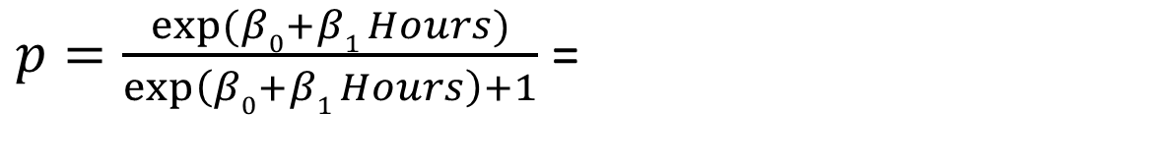

Fixing the approach
So how can we achieve both the constraints?
It must always be positive
It must be less than 1
The above formula can be rewritten as:
=
= e
=

Slide 6
Logistic model plot

Slide 7
Logistic Regression
It aims to:
Model the probability of an event occurring depending on the values of the independent variables, which can be categorical or numerical.
Estimate the probability that an event occurs for a randomly selected observation versus the probability that the event does not occur.
Predict the effect of a series of variables on a binary response variable.
Classify observations by estimating the probability that an observation is in a particular category.

Slide 8
Logistic Regression – contd…
Logistic Regression is based on the concept of “Odds Ratio”.
Here the estimates of effect are quantified by odds ratio rather than means.
Odds Vs Probability

Slide 9
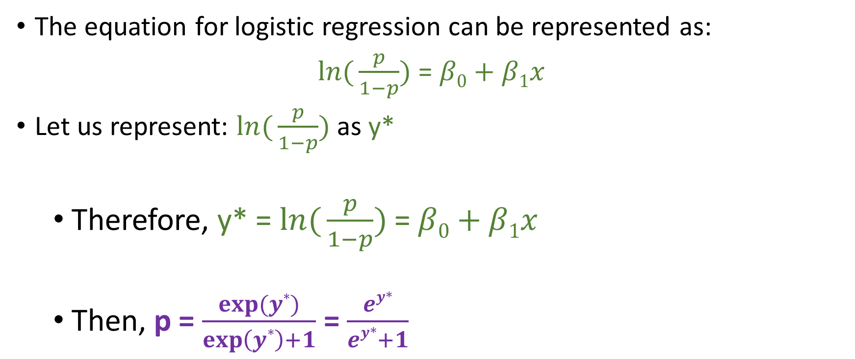
Equation for Logistic Regression
The equation for logistic regression can be represented as:
=
Let us represent: as y*
Therefore, y* = =
Then, p = =

Slide 10
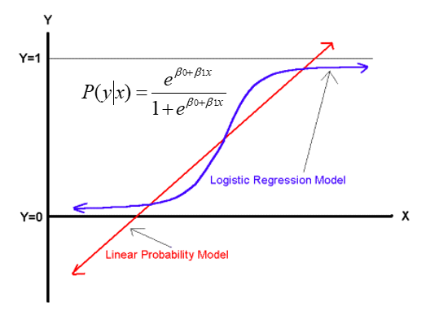
Comparing the linear and logistic regression model

Slide 11
Multivariate Regression
It is a method used to measure the degree at which more than one independent variable (predictors) and more than one dependent variable (responses), are linearly related.
The method is broadly used to predict the behavior of the response variables associated to changes in the predictor variables, once a desired degree of relation has been established.
Example:

Slide 12
References
[1] https://www.youtube.com/watch?v=zAULhNrnuL4
[2] https://brilliant.org/wiki/multivariate-regression/

Slide 13
Thanks

